Slide 1
MAP REPRODUCTION

Slide 2
Map Reproduction
Map Reproduction
Most of the maps are made to be duplicated
Map Reproduction is methods for obtaining duplicate print copies from a original picture, map or drawing
It refers to the physical printing of a map using inks on paper or
the electronic duplication of a map in digital form
When large numbers of maps are required issues of cost and time become critical.
Reproduction concept : decreasing unit cost with increasing
number of copies.

Slide 3
Map Reproduction
Map reproduction involves
A. The printing of a map (print reproduction)
For a small number of copies,
Personal printers or large-format inkjet printers suffice.
For a large quantity or for high-quality printing,
Offset printing is typically required.
B. The electronic duplication of a map in digital form (non print reproduction)
An increasing number of maps are being reproduced and disseminated on electronic media and via the internet.

Slide 4
Map Reproduction
Map dissemination refers to the distribution of reproduced maps in physical or electronic form.
Electronic duplication and Electronic distribution,
Maps are duplicated and distributed simultaneously.
Non print reproduction and dissemination methods
Computer-based
Local area network (LAN)
Internet- and web-based
Duplicate copies of maps were made by hand before development of number of reproduction technologies (mechanical, photomechanical and electronic reproduction).

Slide 5
Map Reproduction
Selection of duplication process depends on
Intended audience and purpose of the map
Number of copies
Desired quality of output map
The size of paper
Cost of production
Material to be used
Color print , number of color or gray tones
……………….

Slide 6
Map Reproduction
Map reproduction methods
Depends on quantity of map production
Methods for few copies
Xerography
Methods for many copies
Relief Printing
Intaglio printing
Stenciling printing
Lithography

Slide 7
Map Reproduction
Methods for few copies
Xerography
Most commonly used method for small scale map
Xeros and Graphos mean “ Dry writing”.
Xerography or electrophotography is a dry photocopying technique.
Process for producing copies of text or graphic material by the use of light, heat, chemicals, or electrostatic charges.
No chemical reactions
An electrostatic process that involves photoconductivity and surface electrification

Slide 8
Map Reproduction
Xerography process:
Basis of the xerographic process or electrophotography relies on
following fundamental steps.
The charging of a photoconductor (selenium)
Exposing the photoconductor or image exposure,
The development of the latent image,
Transferring the newly formed image from the photoconductor to a sheet of paper or other medium,
Fusing or permanently fixing the image to the medium and
Finally cleaning and restoring the photoconductor for future use

Slide 9
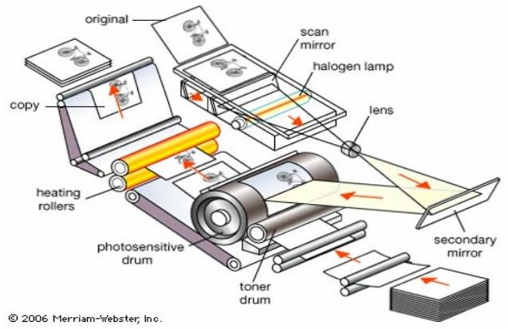
Map Reproduction
Mechanical arrangement of Xerography machine

Slide 10
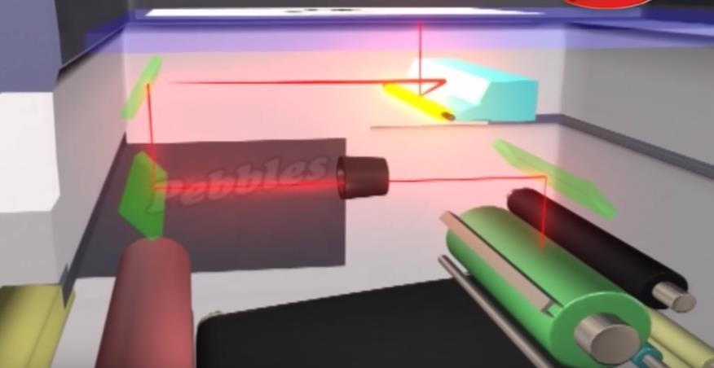
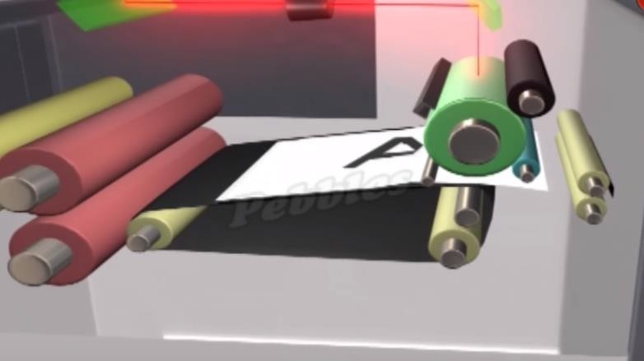
Map Reproduction
Mechanical arrangement of Xerography machine
The charging of
a
photoconductor (selenium) and exposing the photoconductor or image exposure
The development of the latent image and transferring the newly formed image from the photoconductor to a sheet of paper

Slide 11
Map Reproduction
Methods for low-volume print reproduction such as laser and ink-jet printing become too costly or time consuming when reproducing large numbers of maps.

Slide 12
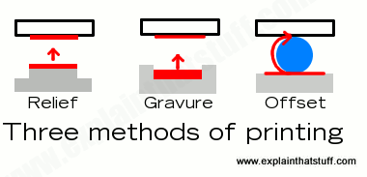
Map Reproduction
Methods for many copies
Modern high speed printing press produce thousand of copies per hour
The cost of each copy is as cheaply as first copy or cheaper
Many copy methods become more economical as the number of copies grows
The most economical way to produce map in a large numbers is from a special plate using mechanical printing process.
Three approaches for creating plates for reproduction work
Relief Printing
Intaglio printing
Stanciling printing
Lithography

Slide 13
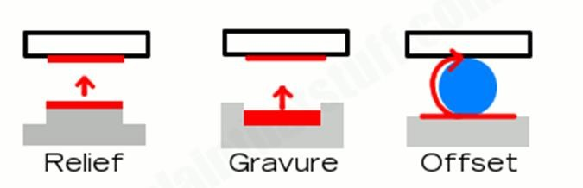
Map Reproduction
Relief Printing
Method where a printing block, plate or matrix that has had ink applied to its surface, but not to any recessed areas, is brought into contact with paper.
Paper receive ink directly from the surface standing in relief
Early period block of wood is now replaced by photographic
image transfer and chemical etching of plastic or metal plates
The areas of the printing plate with ink will leave ink on the paper,
The recessed areas of the printing plate will leave the paper ink-
free.
Example : rubber stamp

Slide 14
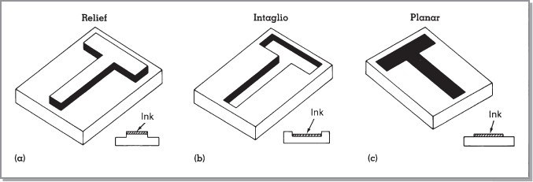
Map Reproduction
Traditional Manual approach in printing a) Relief b) Intaglio and C) Planar

Slide 15
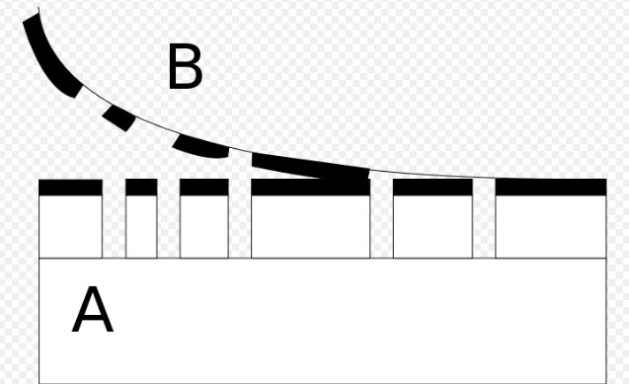
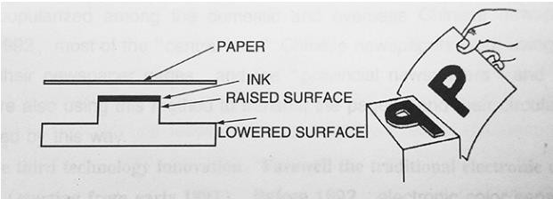
Map Reproduction
The basic concept of relief printing. A is the block or matrix; B is the paper; the thick black lines are the inked areas
By Lithoderm - Own work, CC BY-SA 3.0, https://commons.wikimedia.org/w/index.php?curid=5078581
Relief printing: the lower surface does not print because it does not contact with ink or paper

Slide 16
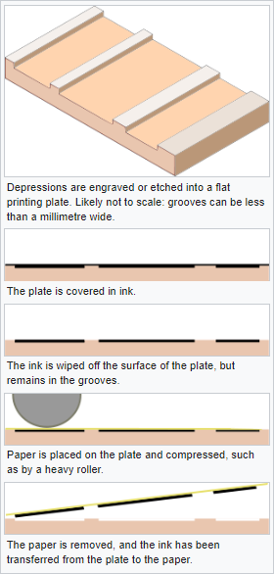
Map Reproduction
Intaglio printing
Image is incised into a surface and the incised line or
sunken area holds the ink.
It is the direct opposite of a relief print.
Normally, copper or zinc plates are used as a surface
or matrix
The incisions are created by etching, engraving, dry point, aquatint or mezzotint.

Slide 17
Map Reproduction
Lithography printing
Lithography (from Ancient Greek lithos, meaning 'stone', and
graphein, meaning 'to write')
The printing is from a stone (lithographic limestone) or a metal plate with a smooth surface.
Lithography is a printing process in which ink is made to stick only to certain areas of a printing surface (through chemical means), and is subsequently transferred to a print medium (e.g., paper).
In modern lithography, the image is made of a polymer coating applied to a flexible plastic or metal plate.
Originally based on the immiscibility of oil and water.

Slide 18
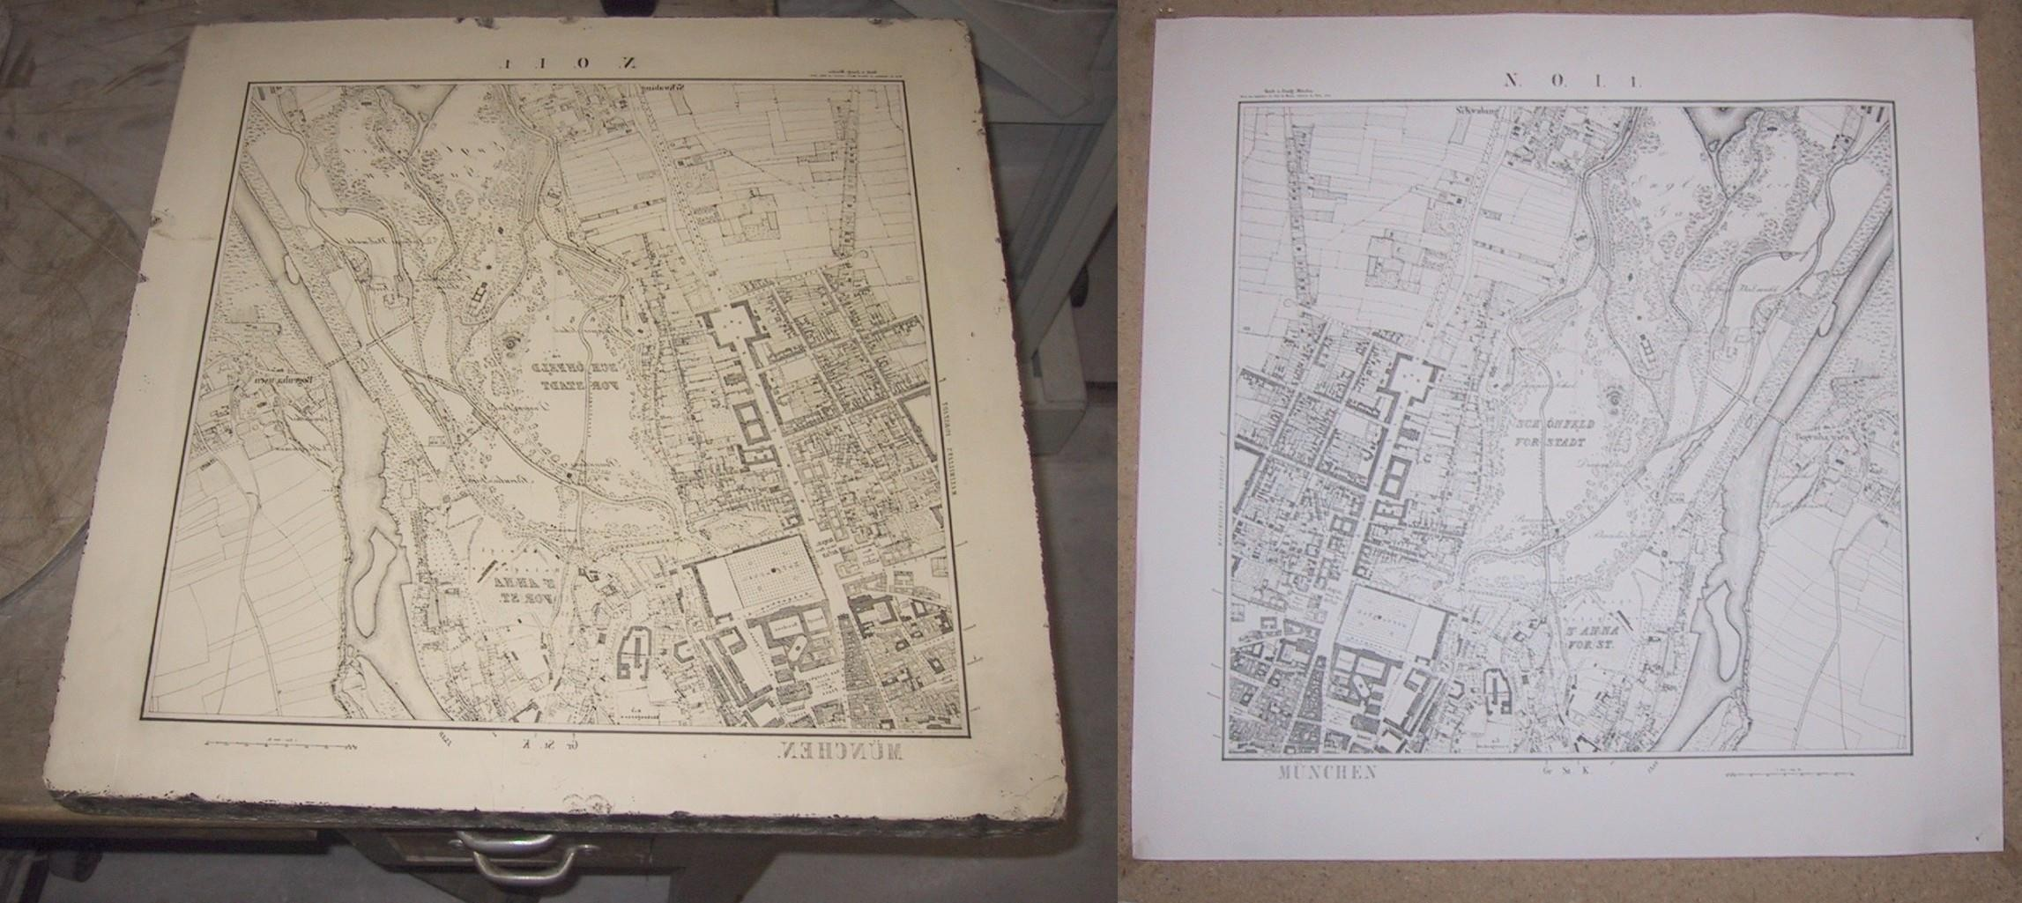
Map Reproduction
Lithography stone and mirror image print of a map of Munich with Lithography negative stone (Left) and positive paper
By Chris 73 / Wikimedia Commons, CC BY-SA 3.0, https://commons.wikimedia.org/w/index.php?curid=600368

Slide 19
Map Reproduction
Offset lithography or offset printing
Most of mass-produced maps are the result of offset lithography
Characterized by excellent print quality, high printing speed
Significant decrease in the cost per unit as the number of copies increases
Offset presses are mechanical printing devices that incorporate aspects of photographic and digital technologies
In offset printing the image is first transferred, or offset to the rubber blanket cylinder (intermediate printing surface ) and then image is transferred to the print medium.

Slide 20
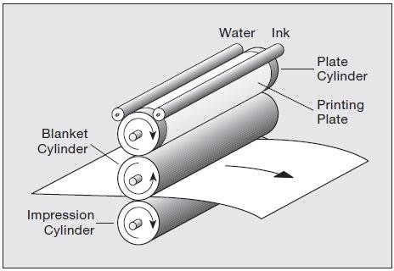
Map Reproduction
There are three cylinders in each unit:
primary printing
The plate cylinder, to which a printing plate is mounted.
the blanket cylinder, which receives an image from a printing plate and
subsequently transfers it to the print medium.
A printing unit (Simplified) of an offset lithographic
printing
The impression cylinder, which helps move the print medium through the press.

Slide 21
Map Reproduction
Process of offset printing
The offset lithographic reproduction of maps consists of various technologies, several steps and procedures that make offset lithographic printing possible in a single color or multicolor.
Generally Process offset printing
Preparation of digital map file (map original)
Producing Printing plates or Plate Making
Proofs making
Map production

Slide 22
Map Reproduction
Preparation of digital file
A more attractive option is to deliver the digital map in a portable document format such as Encapsulated PostScript (EPS) or Portable Document Format (PDF).
An EPS file is a subset of the PostScript page description language that allows digital maps and other documents to be transported between software applications and between different types of computer.
EPS files also have the ability to embed related data and fonts.
A PDF file is similar to an EPS file in that it is related to
PostScript but is “smarter” and more efficient.
In addition to being able to embed related data and fonts.

Slide 23
Map Reproduction
Producing Printing plates or Plate Making
Offset printing works by transferring an image onto a metal sheet known as printing plates through a photomechanical or photochemical process.
Printing plates are thin, flat sheets of metal commonly made from aluminum.
At first the map original is processed to make transmission film or digital form.
Next step is plate making
Modern printing plates have a brushed or roughened texture and are covered with a photosensitive emulsion.

Slide 24
Map Reproduction
Plate Making
One method of plate making is that a photographic negative of the desired image is placed in contact with the emulsion and the plate is exposed to ultraviolet light.
After development, the emulsion shows a reverse of the negative image, which is thus a duplicate of the original (positive) image
Other process is now possible to eliminate the photographic process of making film color-separates by taking digital data directly to plate.

Slide 25
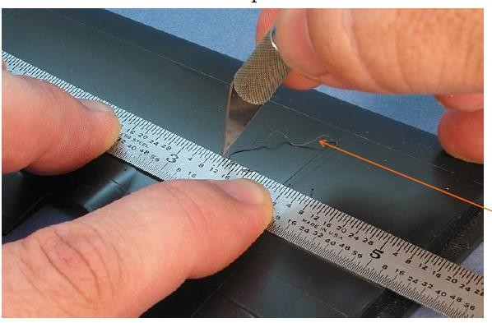
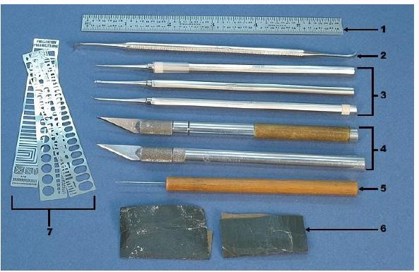
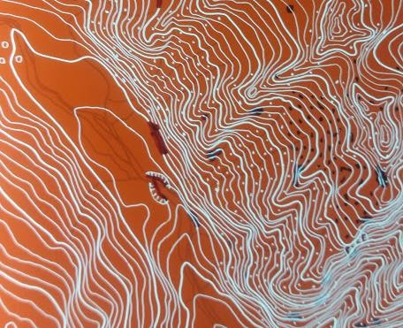
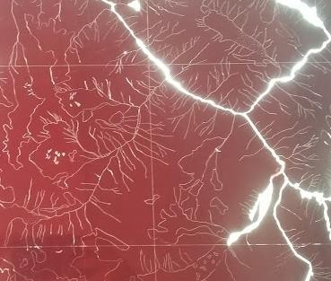
Map Reproduction
Scriber tools
Map original

Slide 26
Map Reproduction
Computer-to-Plate and Direct-to-Press
Computer-to-plate (CTP) is newer method also known as direct- to-plate, increasing in popularity
CTP is the ability to output text and images directly from a digital file to press plate material
The printing plate is normally coated with a photosensitive material and is photographically etched when selectively exposed to laser light within the plate setter, although some plate setters use thermal technology for imaging.

Slide 27
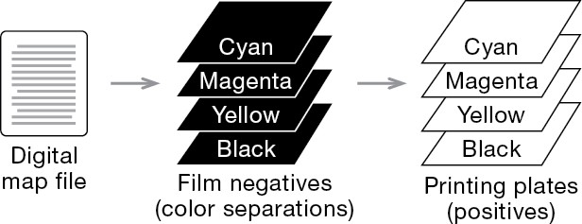
Map Reproduction
Computer-to-Plate and Direct-to-Press
This method is similar to traditional offset lithography, except that the film negative component is bypassed entirely; instead, the printing plate is digitally imaged by a plate setter, directly from a digital map file.
Direct-to-press methods are based technology (direct imaging presses) or (digital toner-based printing)
on either offset lithographic color laser printing technology
Traditionally created
from film negatives.
Replaced by Computer-To-Plate (CTP) technology

Slide 28
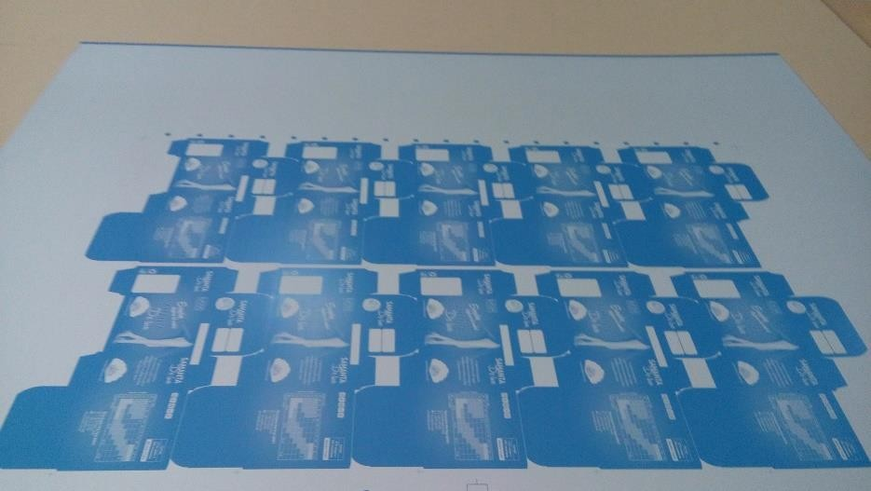
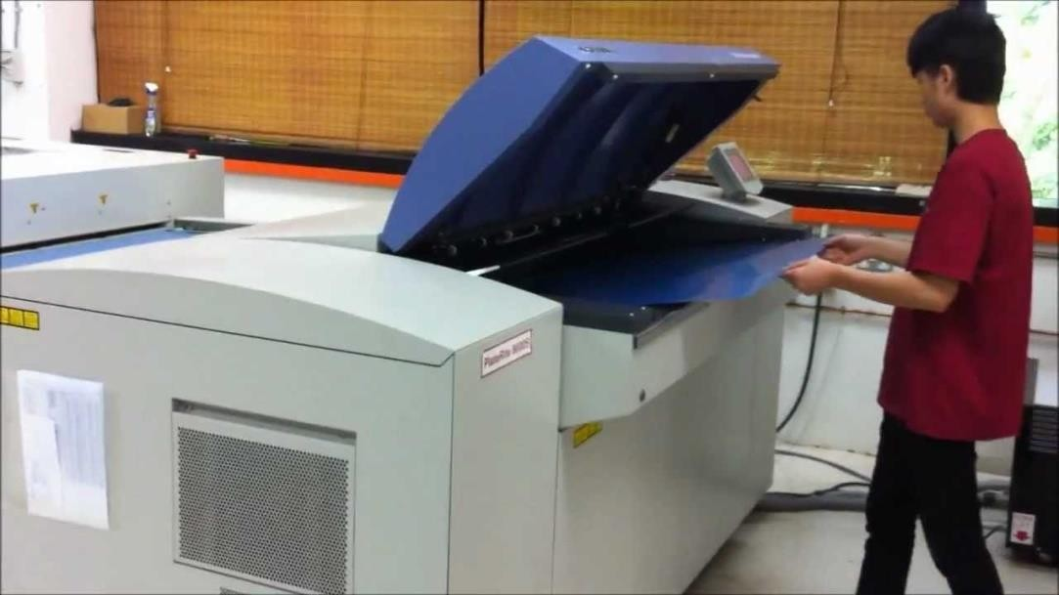
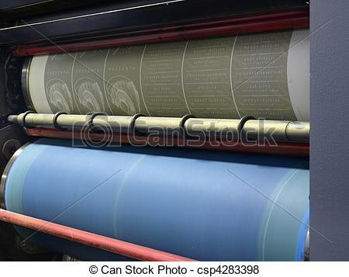
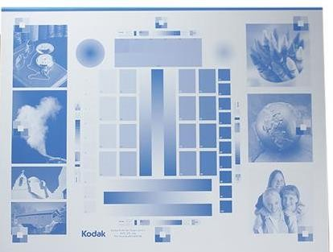
Map Reproduction
Example of offset printing plate
Making CTP plate
Printing plates in offset printing press

Slide 29
Map Reproduction
CTP is very attractive because
Printers will no longer need to handle and dispose of the
chemicals associated with film and developing solutions.
Print quality is also improved in the CTP process.
Because the digital data can be generated straight to the plate without the intermediate steps required for film separates, potential errors are reduced or eliminated.
The positive image is the emulsion that remains after imaging.
Elimination of the photographic process cuts production costs by reducing personnel, cutting out expensive film and photographic chemicals, and speeding map production.
CTP methods offer shorter prepress times, and fewer registration problems.

Slide 30
Map Reproduction
Disadvantage
The initial cost of CTP equipment is very high
Proofing remains a problem with offset-oriented devices
High-quality, separation-based proofs are created directly from film negatives; without negatives, alternative, lower-quality forms of proofing must be employed.

Slide 31
Map Reproduction
Proof making
Verifying and checking different aspect of output map before
printing in huge scale
Checking of color quality and color balance
Registration of plates
Final size of output product
An essential component of the prepress phase
In print reproduction, the correction of errors during editing is generally cheapest when working with crude proofing methods, and becomes increasingly expensive with more sophisticated proofing methods.

Slide 32
Map Reproduction
Proofs are useful in both low-volume and high-volume reproduction, but the emphasis here is on proofing for high- volume reproduction using an offset press.
Proofing can be done on
On-screen display (or soft proofing
monochromatic composites
Color composites
Separation-based proofs
Proofs are created using various technologies and are produced
by individuals, service bureaus, and press operators.

Slide 33
Map Reproduction
Offset lithography working procedure
There is single plate for single color maps and one plate for
every color in multiple color maps as the design to be printed.
The printing plates are attached to cylindrical plate holders where ink and water are applied as the paper material passes through.
Dampening rollers apply water, which covers the blank portions of the plate but is repelled by the emulsion of the image area.
Hydrophobic ink, which is repelled by the water and only adheres to the emulsion of the image area, is then applied by the inking rollers.

Slide 34
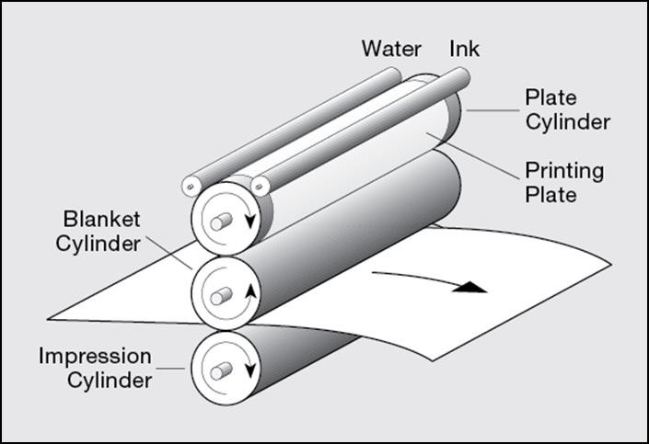
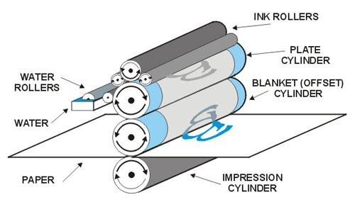
Map Reproduction
Mechanical Arrangement of Offset Lithographic Printing
Transformation of image from the printing plate to the blanket cylinder, and onto the paper

Slide 35
Map Reproduction
Offset lithography working procedure
If this image were transferred directly to paper, it would create a
mirror-type image and the paper would become too wet.
Instead, the plate rolls against a cylinder covered with a rubber blanket, which squeezes away the water, picks up the ink and transfers it to the paper with uniform pressure.
The paper passes between the blanket cylinder and a counter-pressure or impression cylinder and the image is transferred to the paper.
Multicolor print jobs employ multiple printing units, one for each base color
The print medium receives a different color ink from each printing unit
After passing through each unit final map prepared.

Slide 36
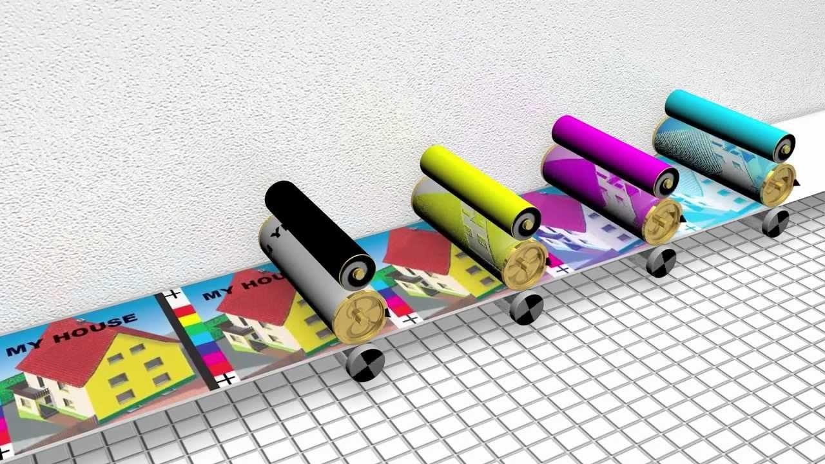
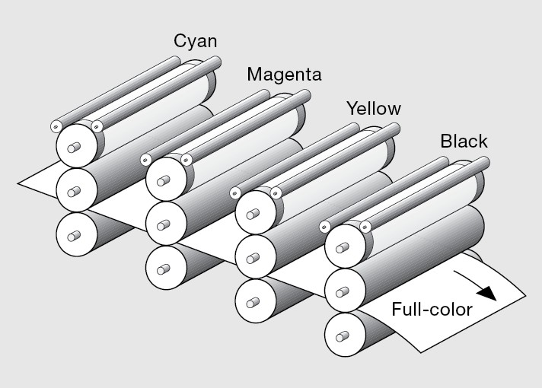
Map Reproduction
Mechanical arrangement of multicolor Offset Lithographic Printing
The print medium receives a different color ink from each printing unit

Slide 37
Map Reproduction
Important factors for map in map reproduction
Screening for print reproduction
Color in Map Reproduction

Slide 38
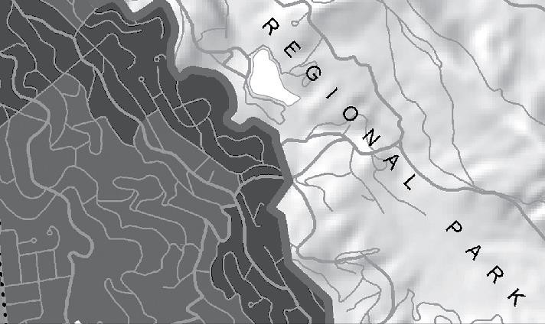
Map Reproduction
Screening
Screening is a technique used in most print reproduction methods in which colors are made to appear lighter by reducing the amount of ink or toner applied to the print medium.
Screening (printing) is a process that represents lighter shades as tiny
dots, rather than solid areas, of ink by passing ink through.
Used to create tints of a base color, and to represent continuous tone surfaces

Slide 39
Map Reproduction
A tint is a lighter version of a base color: Gray is a tint of the base color black, and pink is a tint of the base color red.
A continuous tone surface is composed of tints that continuously vary in lightness within a given area.
The human eye is capable of combining the color of the individual dark green dots with the white of the underlying print medium.
This allows the map user to perceive light green instead of dark green; the pattern itself typically goes unnoticed.
Two categories of screening
Halftone
Stochastic

Slide 40
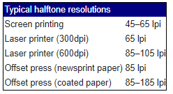
Map Reproduction
Halftone screening
Halftone is the reprographic technique that simulates continuous-tone imagery through the application of ink or toner in a pattern of equally spaced dots of variable size,
The size of each dot determines the degree of lightness that is achieved; the smaller the dot, the lighter the result,
Color printing is made possible by repeating the halftone process for each subtractive color
The semi-opaque property of ink
allows halftone dots of optical
different colors to create another imagery.
effect, full-color
300 line per inch or 120-150 line per inch

Slide 41
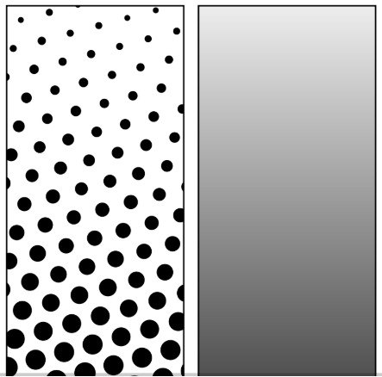

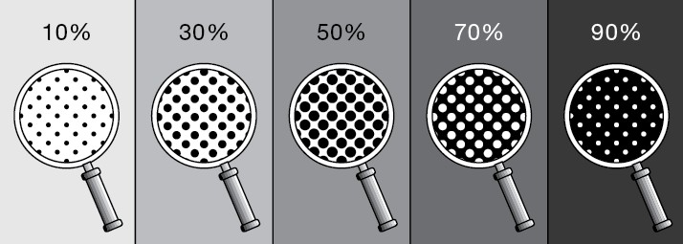
Map Reproduction
Left: Halftone dots. Right: How the human eye would see this sort of arrangement from a sufficient distance.
Amplitude Modulation (A.M.)

Slide 42
Map Reproduction
Halftone screening
For continuous copy, such as relief shading or photographic image, must be converted to a halftone negative prior to printing.
This reproduction relies on a basic optical illusion
Halftone screening is sometimes referred to as amplitude modulation (AM) screening because variations of lightness are achieved through the alteration of the size, or amplitude, of each dot
Halftone screening is used in almost all print reproduction methods, with the exception of inkjet printing, which normally employs stochastic screening.

Slide 43
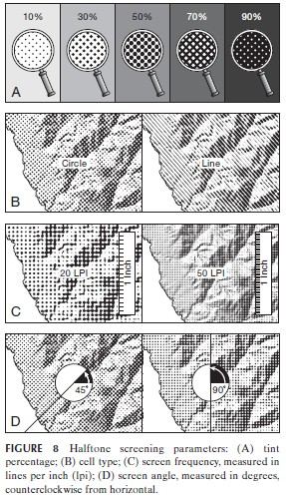
Map Reproduction
Halftone Screening Parameters
The tint percentage controls the degree to which the appearance of an ink or toner is lightened
The cell type refers to the shape of each individual mark of the halftone pattern; the circle (dot) is the most widely used shape, but the line and other shapes are also used
Screen frequency, or screen ruling, refers to the spacing of halftone dots within a given area, or, more specifically, the spacing of the lines that the dots are arranged
The screen angle parameter controls the angle at which the lines of halftone dots are oriented, as illustrated in

Slide 44
Map Reproduction
Stochastic screening
Stochastic screening involves the application of ink or toner in a pattern of very small, pseudorandomly spaced dots of uniform size
The density of dots within a given area determines the degree of lightness that is achieved. (dots spaced farther apart produce lighter results.)
Stochastic screening is also referred to as frequency modulation (FM) screening because variations of lightness are achieved through the alteration of the spacing, or frequency, of each dot.

Slide 45
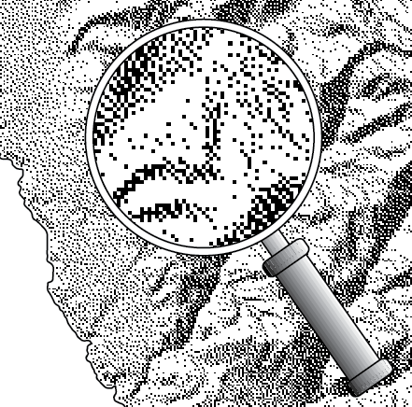
Map Reproduction
The term stochastic refers to the pseudorandom approach used to place dots within a given area.
Stochastic screening is typically controlled by one parameter only: tint percentage.
Tint is specified in percentage, with lower values resulting in
lighter colors.
Frequency Modulation (F.M.)

Slide 46

Map Reproduction
Process colors
The more common method of offset printing involves process colors; these colors are produced by a combination of cyan, magenta, yellow, and key (black) or CMYK color or process color.
Each process color is comprised of percentages of cyan, magenta,
yellow, and black inks.
Mixed on the page by applying them, in sequence, to the same area
Cyan
+ Black
Magenta
Yellow

Slide 47
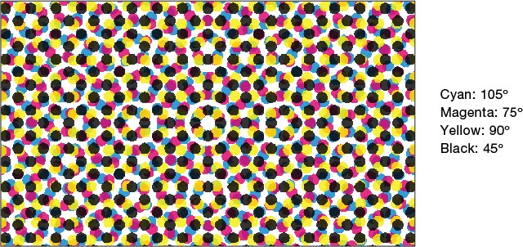
Map Reproduction
Inks and toners based on the process colors are semi opaque, or translucent, allowing them to combine on the page; new colors are created where the process colors overlap.
When mixed on the page, tints of each base color are represented by halftone patterns, each with a unique screen angle
Rosette Pattern

Slide 48
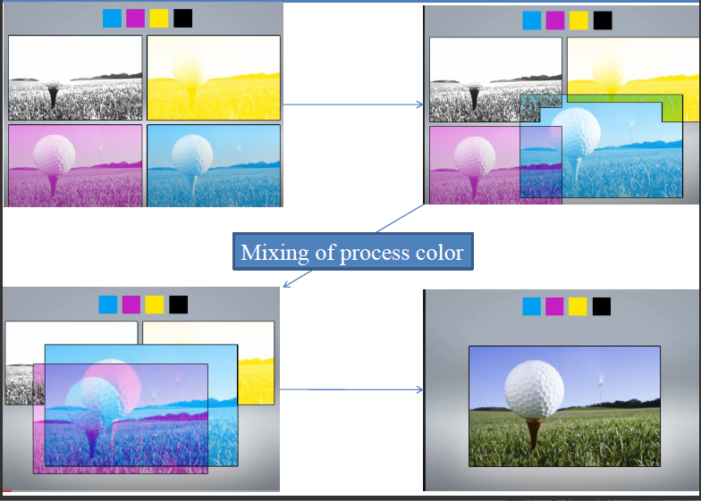

Slide 49
Map Reproduction
Screen angle and screening techniques, allows for the creation of a wide variety of colors and is referred to as four-color process printing.
When process colors are mixed on the page, tints of each base color are represented by halftone patterns, each with a unique screen angle to avoid moiré patterns.
Four-color process printing is an efficient method of producing many colors from four base colors

Slide 50
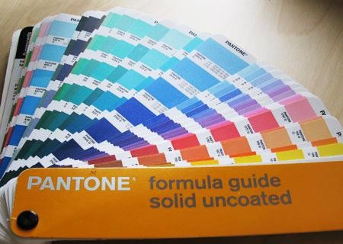
Map Reproduction
Spot colors
An alternative to mixing process colors on the page is to use
solid colors, or spot colors.
Spot colors take the form of opaque inks that are premixed
before they reach the printing device
In offset printing, spot colors are produced when inks are laid down in a single run.
Tints can be created through screening
Exact color matches are easier to achieve because they do not
rely on the printing device for mixing

Slide 51
Map Reproduction
The Pantone Matching System (PMS) is the most universally accepted spot-color system
A disadvantage of using spot colors is the cost of reproduction when a map has many colors.
Unlike the process colors, which can produce a wide variety of colors through mixing, spot colors require separate inks to be used for each color, increasing the cost of reproduction.

Slide 52
Map Reproduction
Continuous Tone Color Printing
Some printing devices are capable of producing continuous tone
output
Full color prints that are achieved without the use of screening techniques.
Tints are created through subtle variations in the volume or
density of ink or toner applied to the page.
Best suited to printing images of continuous tone such as photographs.
The term contone refers either to true continuous tone printing or to a set of hybrid techniques that incorporate a limited set of continuous tone methods with screening, producing results that approach true continuous tone output.

Slide 53
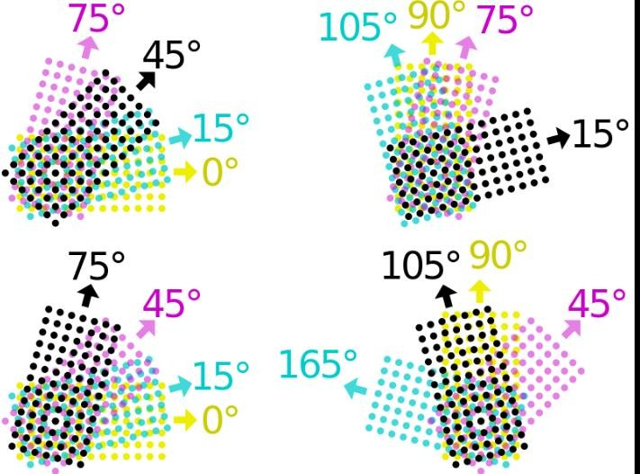
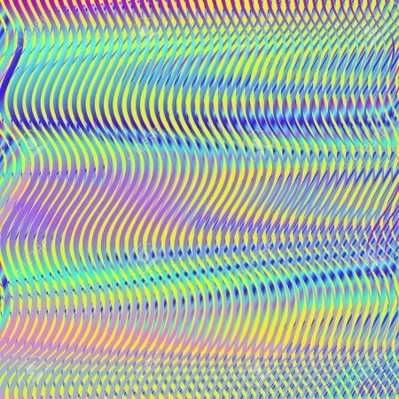
Map Reproduction
Screen Angle
When mixed on the page, tints of each base color are represented by halftone
patterns, each with a unique screen angle
In offset printing, the screen angle is the angle at which the halftones of a separated color is made output to a lithographic film, hence, printed on final product media.
Incorrect set of angles to output every color may lead to a sort of optical noise called a moiré pattern which may appear as bands or waves in the final print.
Incorrect sets of angle values may look colors dimmer due to overlapping.
Examples typical halftone angles
of CMYK
screen
moiré pattern

Slide 54
Map Reproduction
Digital Printing
Modern method that covers a variety of different techniques
including inkjet printing and laser.
In digital printing, images are sent directly to the printer using digital files such as PDFs.
This eliminates the need for a printing plate, which is used in other types of printing such as lithography, and can save time and money (unless you're printing in larger numbers).
Digital printing allows for quick turnaround and allows businesses to print on demand.
It's also great for small run jobs - requests can be made for as little as one print.

Slide 55
Map Reproduction
Digital printing best serves the demand for:
variable data printing,
personalization, customization, less spoilage, faster proof cycle, smaller archival storage, quick response, just-in-time delivery, and short to medium print runs.
One of the most important advantages that Digital printing offers is a quicker response time due to its minimal press setup
Built in multicolor registration system.

Slide 56
Map Reproduction
Advantage and disadvantages of Offset Printing
Advantages
Superior image quality product
Disadvantages
High cost of low-volume jobs
Longer timetable since plates need to be created
Count on offset printing for clean, distinct type and images without streaks or spots
Better color reliability,
Works equally well on
Worse fallout in case there’s an
error
Numerous steps,complex procedure
Expensive equipment's
Too many variables
Product can not be customized to
specific customer requirements
Slow response to change
Long time lag between start to
finish
almost any kind of material.
World wide conventional process
Reprint easy
Less expensive per map

Slide 57
Map Reproduction
Advantage and disadvantages of Digital Printing
Advantages
Disadvantages
Material longevity
Does it meet customer need?
No standard
Fewer options in materials yo u can print on
Less color fidelity
Less expensive process
for low volume jobs
Quick and quicker response to change data manipulation
Customize size, color,
features, number of copies
Printed on demand
Transmission of electronically
Higher cost for large- volume jobs
data
Presumed quality, crispness
slightly sharpness
lower
and
No risk of miss registration

